Slide 1
Think Like a Data Scientist: An introduction to solving data-oriented problems
Brandon Wen

Slide 2
Data Science Mindset
What is the problem?
What is the business problem to solve?
What role can data play in solving the problem?
What does the data say?
What questions can we ask from the data?
Is this data sufficient to solve the problem?
Can we formulate certain hypotheses from the data?
How do we measure the outcome?
What evaluation metrics should we use?
What is the correct interpretation of the outcome?

Slide 3
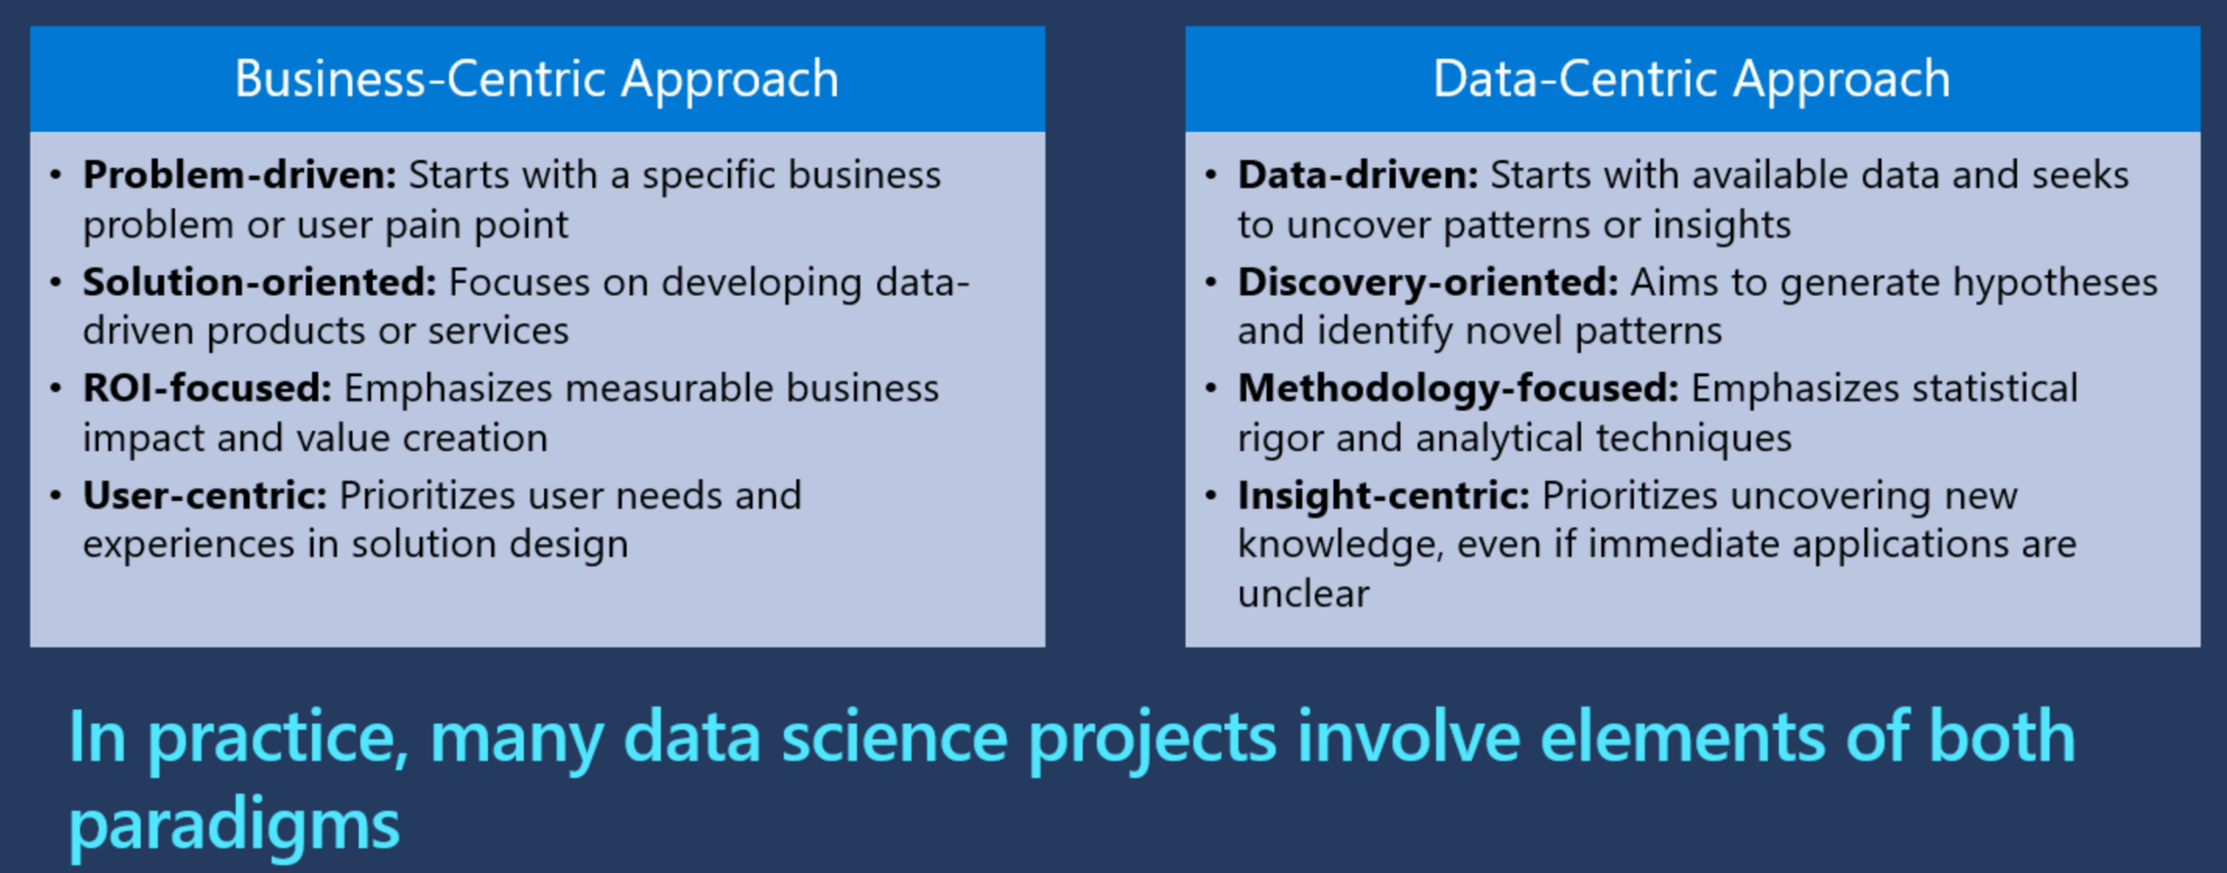
Compare to a Business-Centric Mindset

Slide 4
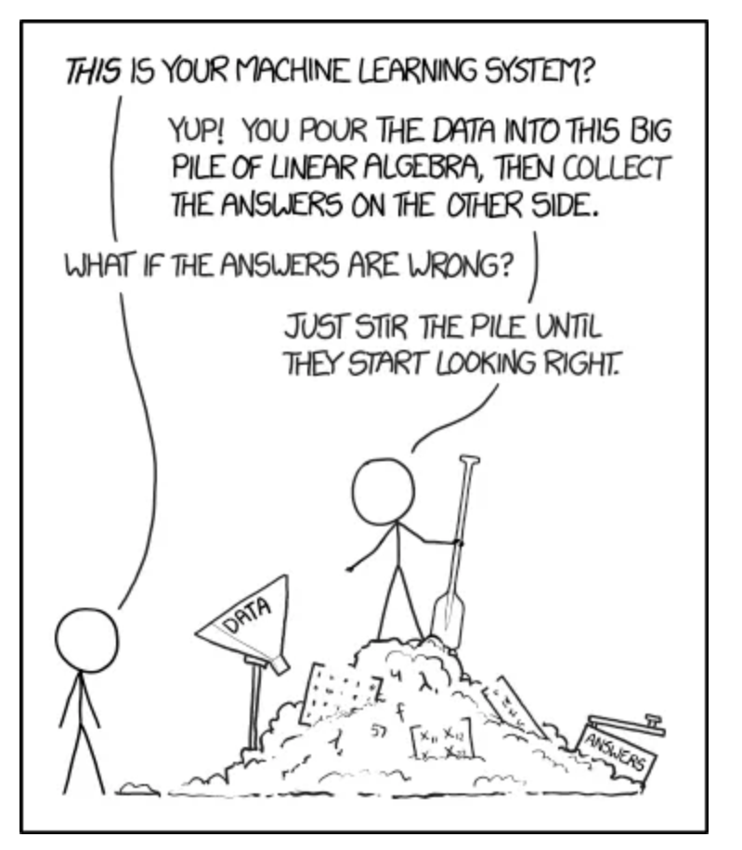
What to Avoid
https://xkcd.com/1838/

Slide 5
Key Questions to Ask
Before even getting the data
What data is available?
What additional data can we (easily) obtain?
How is this data collected?
What format does the data come in?
Data governance and privacy concerns?
How will this data continue to be collected going forward?
Next step: EDA

Slide 6


The Problem It’s not always so simple
What the client says the data looks like
What it actually looks like

Slide 7
Exploring Your Data
EDA
Goal of EDA: Understand your data well enough to start formulating hypotheses to be tested.
Understand the structure of your data
Data source, where does it come from?
Variables and features
Detect patterns and anomalies
Visualize trends
Identify correlations
Identify data quality issues
Holes or significant missing values?
Data that looks incorrect?
Detect outliers
Stale or duplicated?
Select the right tools & techniques
What methods / techniques would be best suited to model this data?
How can we transform this data to maximize its value?
Is the data skewed or biased?
Data format (images, text, JSON, tables)?
Other data to request?

Slide 8
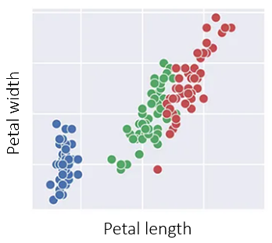
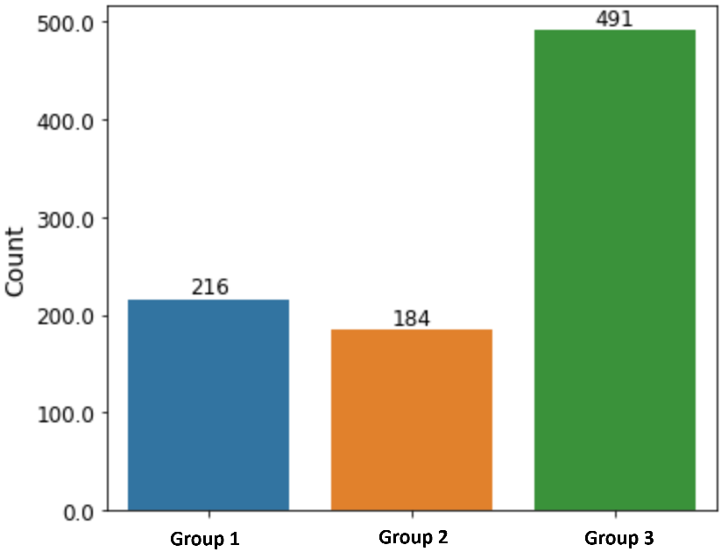

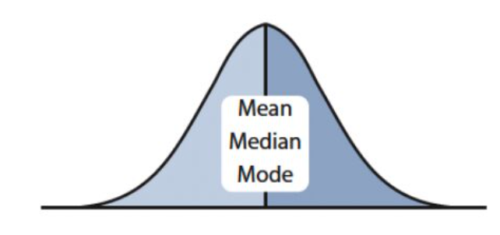
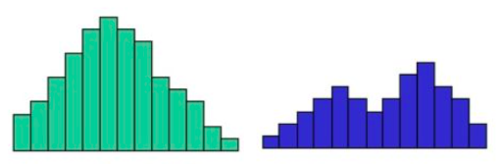
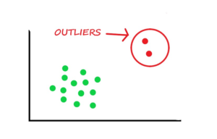
Common Techniques for EDA
Look at the data!
Frequency counts (categorical variables)
Plot correlations
Descriptive statistics
Visualize distributions
Identify outliers

Slide 9
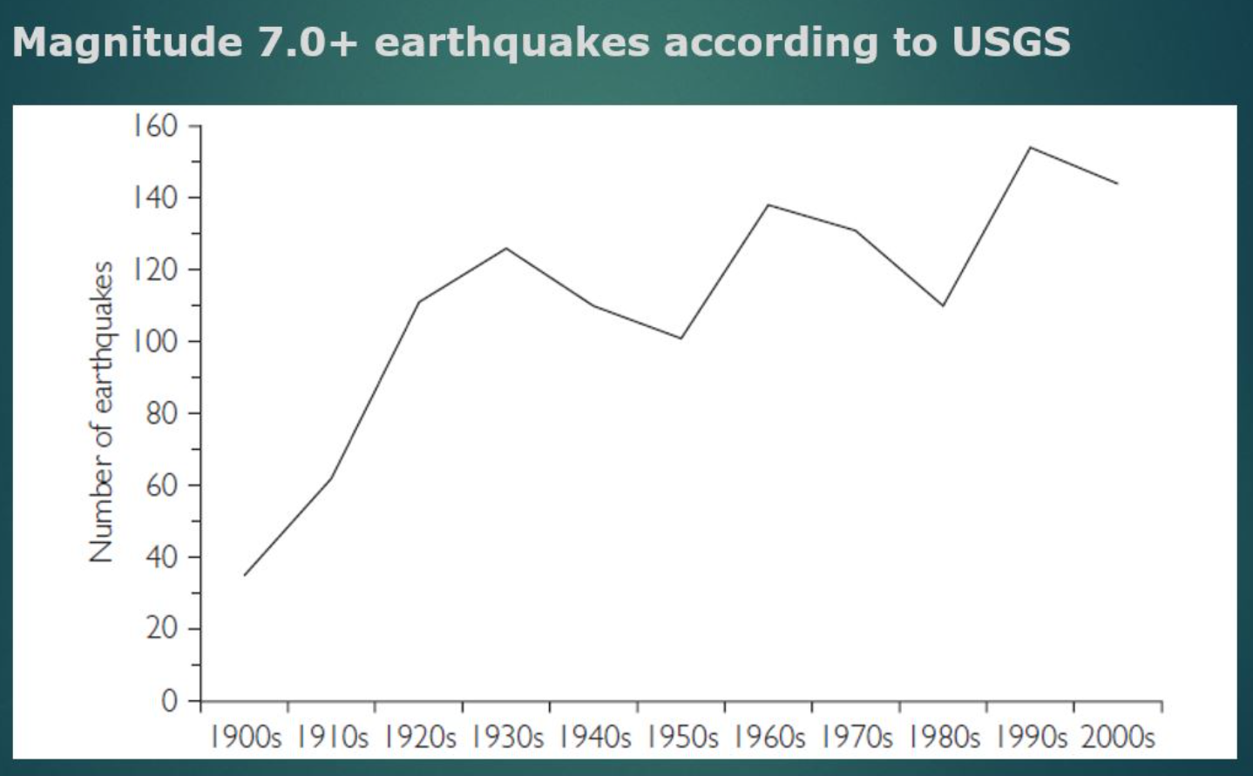
Careful! Again, it’s not so simple
What’s going on here?
Your data may not be telling you everything!
Always be skeptical; use your judgment
When in doubt, don’t hesitate to pose the question to SMEs
Cordes, Jay. “The Scientific Mindset” (2019).

Slide 10
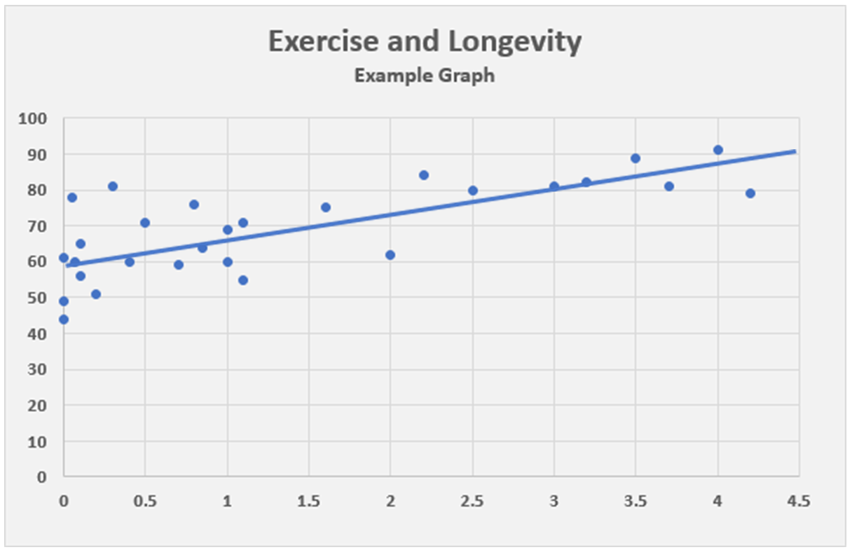
Careful! It’s still not so simple
Non-Smokers
Smokers
*Not actual data
Your data may not be telling you everything!
The truth may be counter-intuitive
You often need to dig deeper than the surface-level

Slide 11

So… What are we looking for?
Is the data sufficient to address our needs?
What variables / features seem important to the problem?
What tools & techniques will work well to model this data?
What data transformation steps would be required?
Business Problem
Any surprising or unexpected findings that are insightful?

Slide 12
So… What about formulating hypotheses?
Is the data sufficient to address our needs?
Hypothesis: Data augmentation will help improve predictive power
What variables / features seem important to the problem?
Hypothesis: Driver age has a significant impact on insurance rates
What data transformation steps would be required?
Hypothesis: Reducing the dimensionality of this highly noisy variable should improve the model’s accuracy
What tools & techniques will work well to model this data?
Hypothesis: Nonlinear models will perform better than linear models, given the data’s complexity
Any surprising or unexpected findings that are insightful?
Hypothesis: A top-selling item before a hurricane is… beer? What other unexpected items should we stock before a storm?

Slide 13
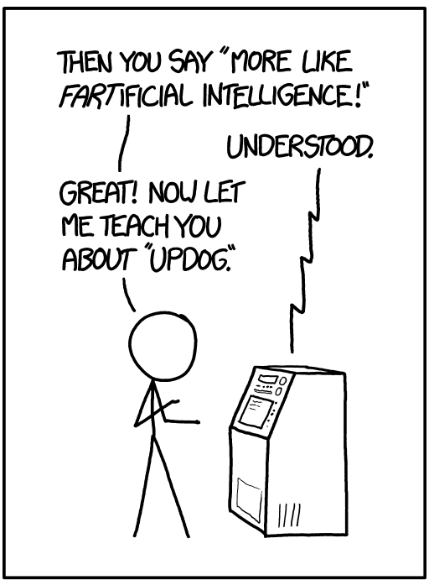
Next: Train the model Call the model API!
https://xkcd.com/1696/

Slide 14
Evaluation
Evaluation is extremely important:
Measure the quality and reliability of a model’s predictions
Assess how well the model generalizes to unseen data
A consistent metric to compare different models and techniques
Identify potential issues with the model (e.g. if the model is underperforming for a particular area of the data)

Slide 15
Evaluation Metrics
Regression
Mean-squared error
Mean-absolute error
Classification
Precision, Recall, & F1
Log-loss
Language Similarity
Cosine similarity
Jaccard distance
Ranking
Normalized Gini
Mean-absolute percentage error
AIC/BIC
Area under ROC
Positive/Negative Predictive Value
Precision @K
Recall @K
Mean-Average Precision
Spearman/Kendall correlation
NDCG
Mean Reciprocal Rank
Levenshtein distance
LLM Evaluators
Relevance
Groundedness
Retrieval
Coherence
Fluency
BLEU & ROUGE
Your evaluation process will depend on the data you’re working with, and the problem you’re solving.

Slide 16
Selecting Evaluation Metrics A few examples
Example 1
Building a regression model to predict home prices
--------------------------------------------------------------------
MSE or MAE, but understand that one is more sensitive to outliers.
Example 2
Testing for the presence of an infectious disease
--------------------------------------------------------------------
Which is more dangerous – a false positive or a false negative?
Example 3
Evaluating the citations from a LLM response
--------------------------------------------------------------------
In theory, token overlap metrics (like F1) could work. But it’s less clear in practice.
Example 4
Evaluating an LLM’s answer to a Named-Entity Recognition task
--------------------------------------------------------------------
Token similarity metrics like F1 would work a lot better here.

Slide 17
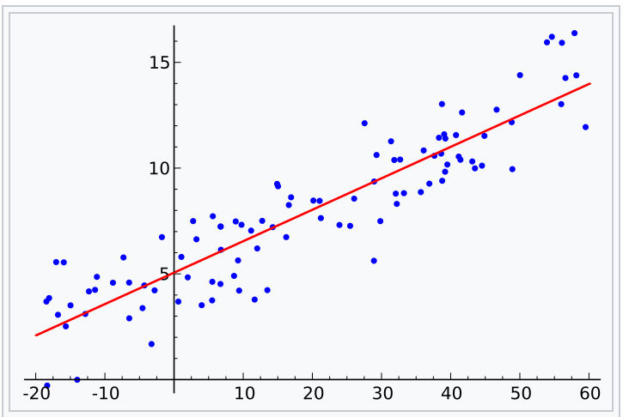
Selecting Evaluation Metrics (1) A few examples
Example 1: Building a regression model to predict home prices
This is a regression problem, so we can select MSE or MAE as our metrics
But: understand that one is more sensitive to outliers
Neither is more “correct”, it depends on how you want your model to respond to the data

Slide 18


Selecting Evaluation Metrics (2) A few examples
Example 2: Testing for the presence of an infectious disease
This is a standard binary classifier. So we can consider precision, recall, or F1
But: which is more dangerous – a false positive or false negative?
Let’s say we’re screening for a rare genetic condition in newborns?
What about the T-virus?

Slide 19
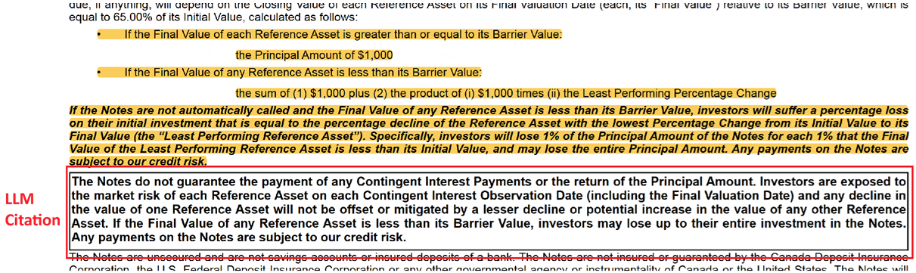
Selecting Evaluation Metrics (3) A few examples
Example 3: Evaluating the citations from a LLM response
Query: Is the bond guaranteed for principal plus interest?
In theory, text-overlap metrics such as BLEU or ROUGE might work
It’s less clear in practice
Can consider context similarity metrics (like cosine), but these aren’t without drawbacks
Labeled citation

Slide 20
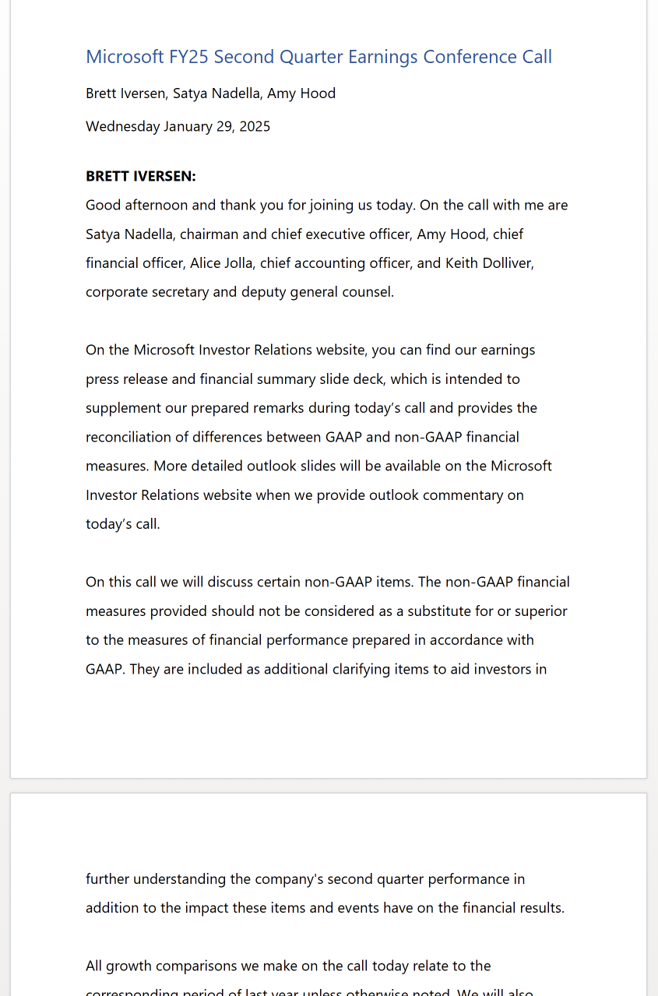
Selecting Evaluation Metrics (4) A few examples
Example 4: Evaluating an LLM’s answer to a named-entity-recognition task
Query: Who are the presenters of this earning’s conference call?
Answer: Brett Iversen, Satya Nadella, and Amy Hood.
Now token overlap metrics make much more sense!

Slide 21
Common Pitfalls
Treating your evaluation metric as a goal, rather than a measurement.
Using a datapoint as a unit test.
No consideration for data drift.
Not treating DS as an iterative process.
Believing that a powerful model can brute-force through bad data.

Slide 22
Thank You!
Questions?

Slide 23

The Workflow* ~CRISP-DM
Cross-industry standard process for data mining | Wikipedia
By Kenneth Jensen - Own work based on: ftp://public.dhe.ibm.com/software/analytics/spss/documentation/modeler/18.0/en/ModelerCRISPDM.pdf (Figure 1), CC BY-SA 3.0, https://commons.wikimedia.org/w/index.php?curid=24930610

